Slide 1

DSC 530 Final Project
Clayton Evans
August 08, 2020

Slide 2
This is a dataset of USA Census data that was extracted to attempt to predict what elements may be in play when predicting if a person would make 50 thousand dollars a year.
The dependent variable is:
income_over_50k
The independent variables are:
sex
age
education
education_num (a number value assigned to the education level above)
marital_status
race

Slide 3
For this data analysis, it was assumed that the key indicator to making over 50 thousand dollars a year may be education level.
The education levels are as follows:
Preschool | 1
1st-4th | 2
5th-6th | 3
7th-8th | 4
9th | 5
10th | 6
11th | 7
12th | 8
HS-grad | 9
Some-college | 10
Assoc-voc | 11
Assoc-acdm | 12
Bachelors | 13
Masters | 14
Prof-school | 15
Doctorate | 16
Assumptions were made to test to see if the impact of being a high school graduate or higher (education_num > 8) would be a strong indicator of predicting if a person had a higher chance of making 50 thousand dollars a year or higher.

Slide 4
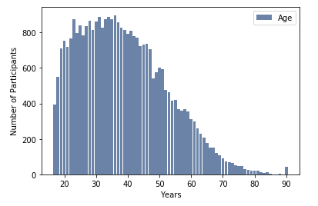
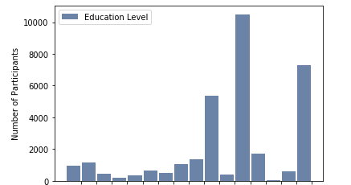
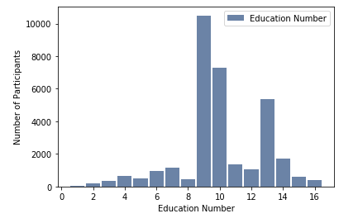
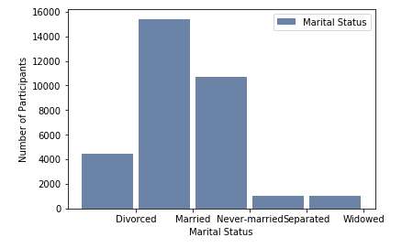
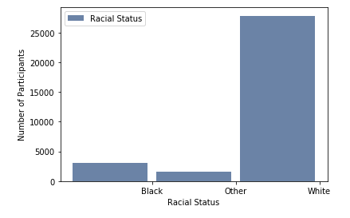
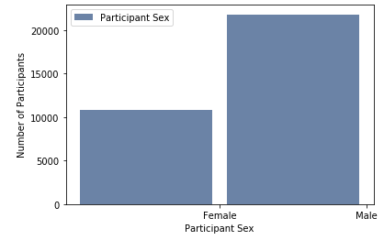
The below histograms for the independent variables are: age (skewed right), education (see previous slide for low to high values from left to right), education number, marital status (skewed right), race (skewed left) and participant sex.

Slide 5
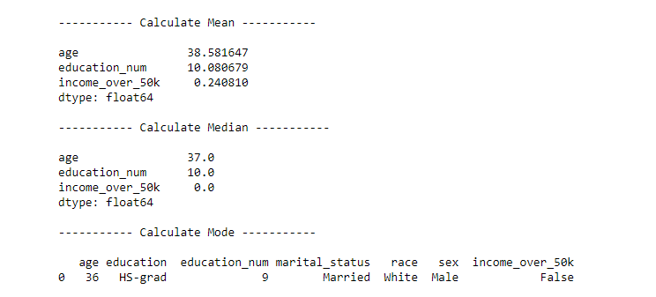
When running a check on the mean, median and mode, the mean and median for education number is close helping to indicate there is no outstanding outlier that would impact the mean. The mode shows that the most common element in the dataset is: 36 years old, HS-grad, education number 9, married, white and male NOT making over 50 thousand dollars a year.

Slide 6
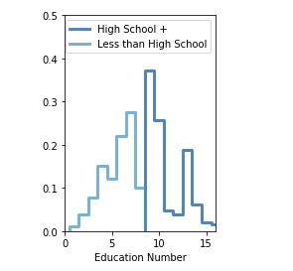
When running a PMF comparison of those with a high school diploma and higher with those having less than a high school diploma the below PMF comparison showed a somewhat normal distribution shape though not precise:

Slide 7
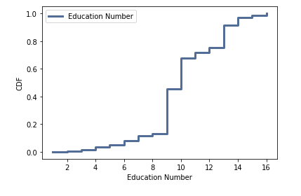
When running a CDF for education number this visual result was generated:

Slide 8
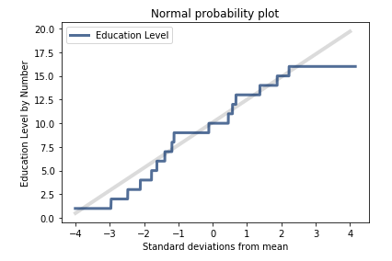
A normal probability plot was run to test if the data was normally distributed which was the general case except for the very high and low education numbers at the ends.

Slide 9
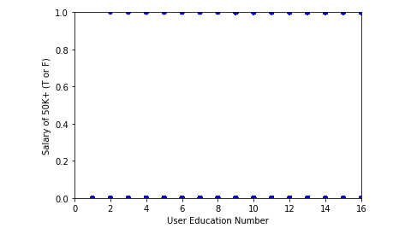
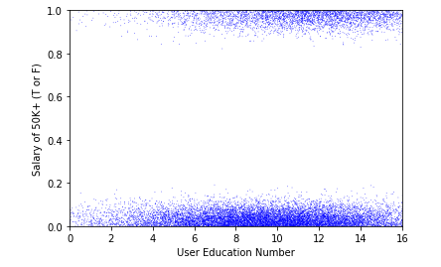
When running scatter plots, a standard scatter plot was not very telling of any tendency but once jitter was added into the plot you could see a noticeable grouping that those that did make over 50 thousand dollars a year were skewed to the side of having a high school diploma or higher.
Of interest, higher education was highly represented in not making 50 thousand dollars a year lead one to wonder on the potential correlation of education and making over 50 dollars a year.

Slide 10
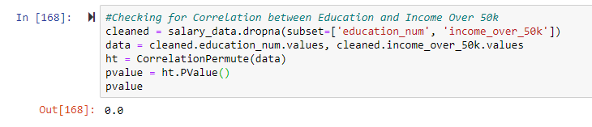
When checking for correlation between education and making 50 thousand dollars a year, there was no correlation at all showing any particular tendency.

Slide 11
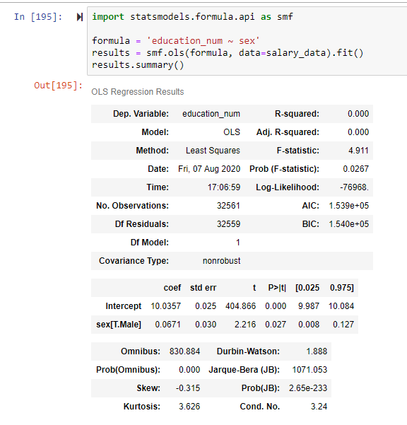
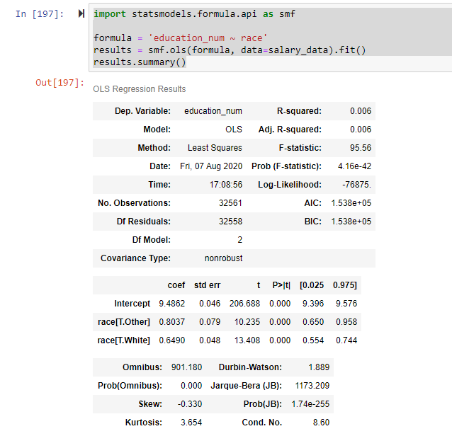
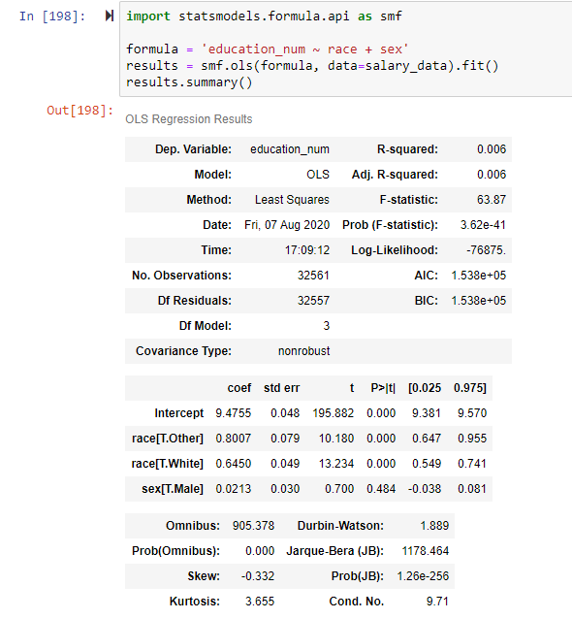
Being that education did have some impact on the possibility of making 50 thousand dollars a year I wanted to see the impact of how race and sex was aligned with education numbers. When testing for sex, being male had a p-value below 0.05 showing that there was a tendency for being male had on your education number.
When testing for race alone though, it appeared that being white and other(non-white, non-African American) had notable impacts on the education number and when combining race with sex, the p-value was significant in showing that being white or other as well as being male had a strong impact on education number having a notable low p-value which could of value when predicting respondents that make over 50k dollars a year.

Slide 12
Conclusion
Seeing that education can have some impact on making 50 thousand dollars a year and that being male and either white or other (non-African American) it would appear that there is some potential to predict a positive result. If a person is female, African American with less than a high school diploma, you would have a notable probability in prediciting that person would not be making over 50 thousand dollars a year.
If a person was a white male with a doctorate there is a good possibility that they may make over 50 thousand dollars a year. That being said, it is important to note that having the above does not guarantee that person is probably making over 50 thousand dollars a year, just that it is more likely that person is compared to other demographics being how sex and race are represented in the education numbers and that the education numbers are grouped with higher education individuals being represented in the income over 50 thousand dollar a year group.
Data set found at: https://www.kaggle.com/uciml/adult-census-income

